Slide 1
Team 12
Video Game Sales Rank
Binglin Zhao Yichen Zhang Ester Park Jiawei Song

Slide 2
Motivation
What: Video games industry is a very lucrative
How: optimize different genres platforms for video games
Who: Demographics are significantly from region to region
The trend of overall market sales
Analyze the empirical causes
Infer strategy for companies and effects
Why visualization?

Slide 3
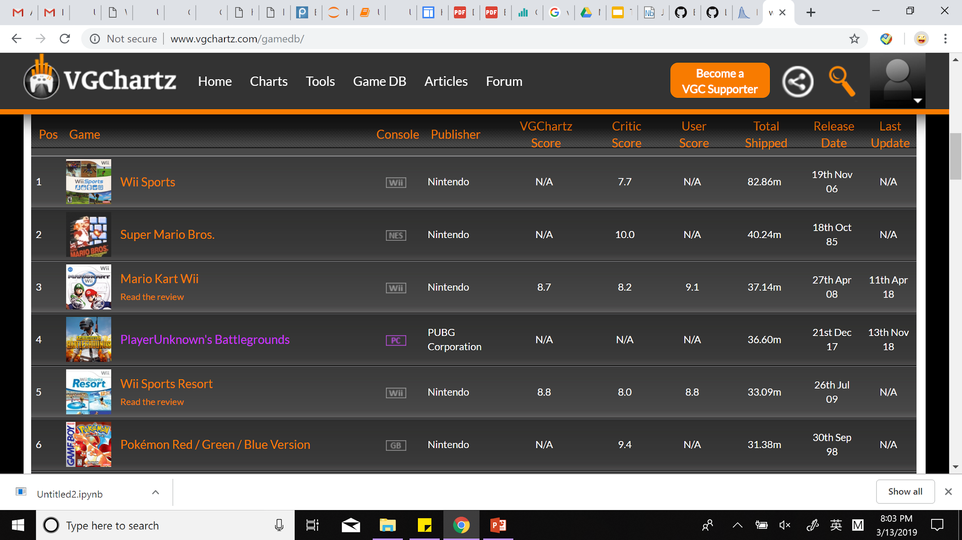
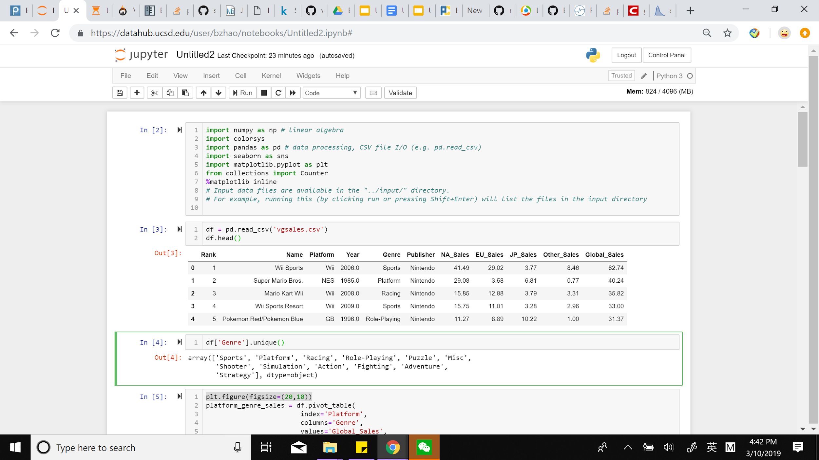
DataSet & Methodology
From : VGChartz http://www.vgchartz.com/gamedb/
Year[1980-2016]; 16323 rows × 16 columns
Counting frequency; Sorting; Calculating Average
Pandas; Seaborns; matplotlib

Slide 4
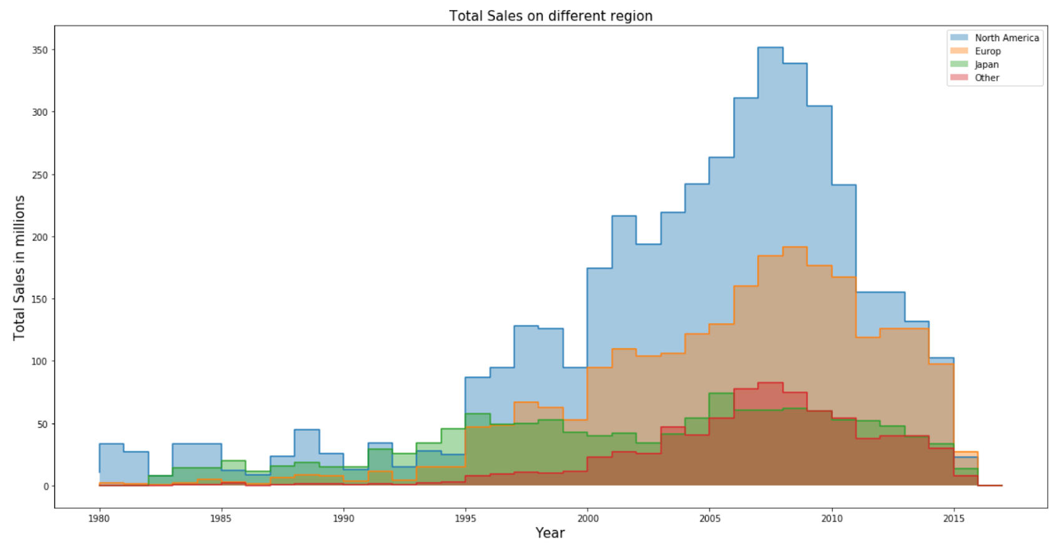
Overall Sales Trend
Time Release Date vs. Regional Economic Constraint
Japanese Debt Crisis 2013
American Recession 2008
European Debt crisis 2010

Slide 5
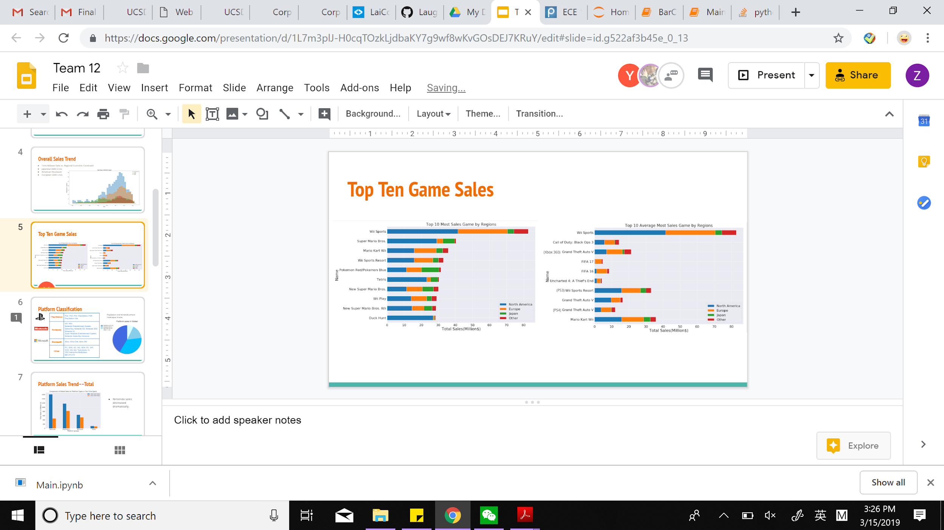
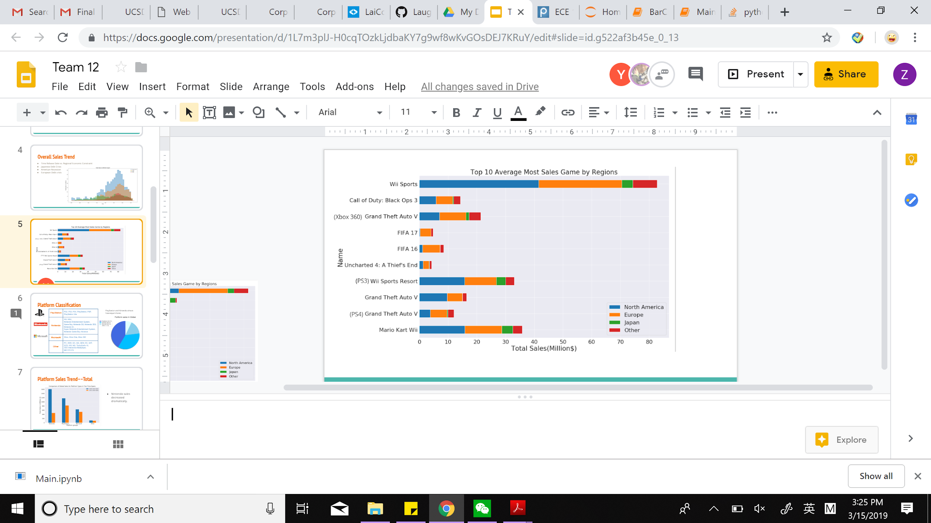
Top Ten Game Sales
Most popular video games unnormalized
New games have bigger market after normalizing it by year

Slide 6

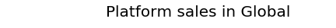
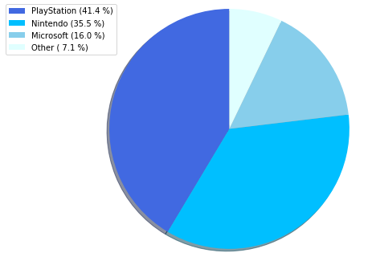


Platform Classification
PlayStation | PS2, PS3, PS4, PlayStation, PSP, PlayStation Vita
Nintendo | Wii, WiiU, Nintendo Entertainment System, Game Boy, Nintendo DS, Nintendo 3DS, Nintendo 64, Super Nintendo Entertainment System, Nintendo Game Boy Advance
Microsoft | Xbox, Xbox One, Xbox 360
Other | PC, 2600, GC, GG, GEN, DC, SAT, SCD, WS, NG, TurboGrafx-16, 3DO Interactive Multiplayer, NEC PC‑FX
PlayStation and Nintendo has relatively equivalent sales
Notes:
-there’s so much black?

Slide 7
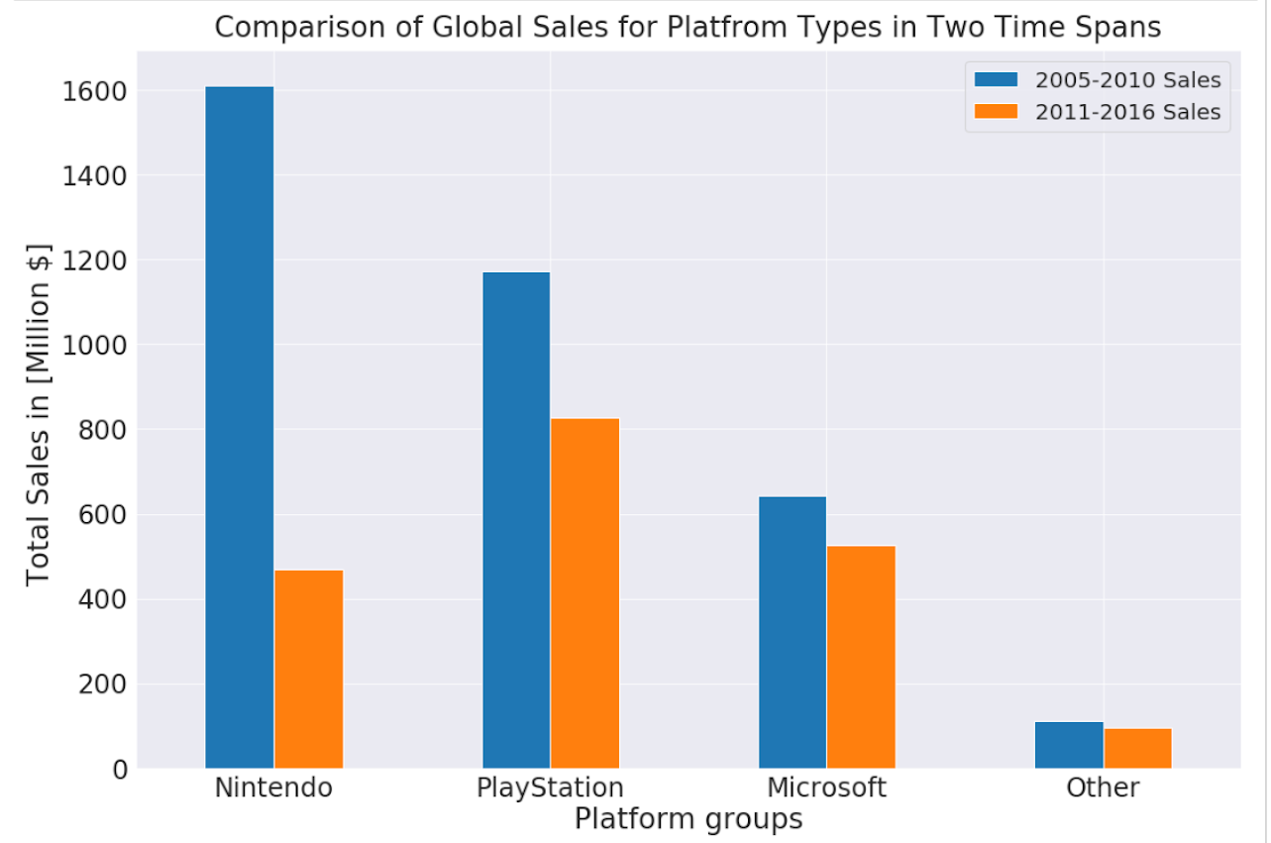
Platform Sales Trend––Total
Nintendo sales decreased dramatically
Notes:
-there’s so much black?

Slide 8
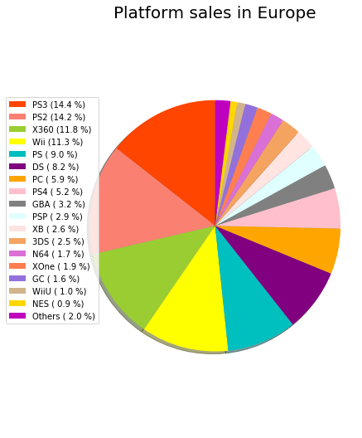
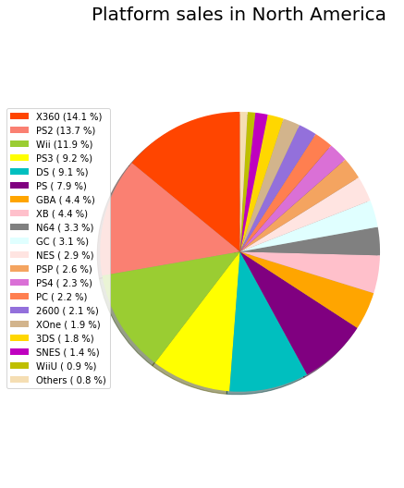
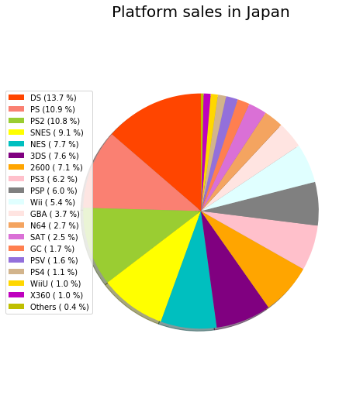
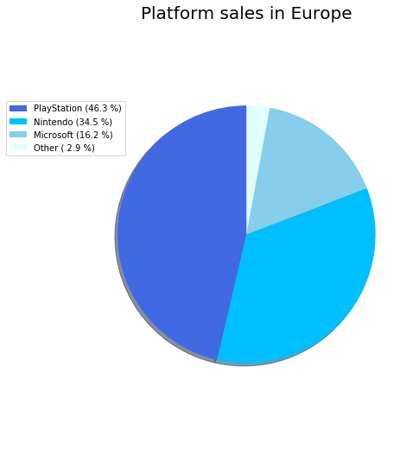
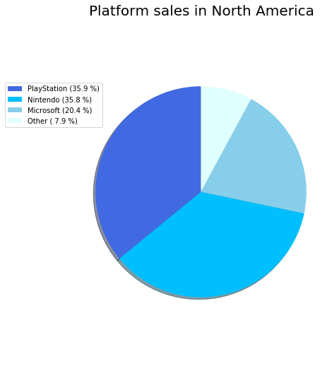
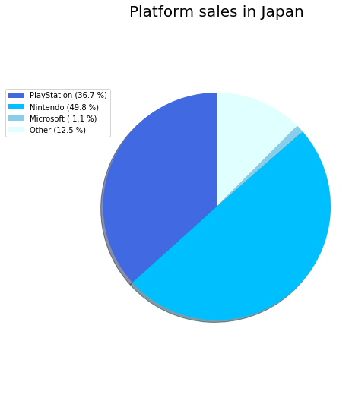
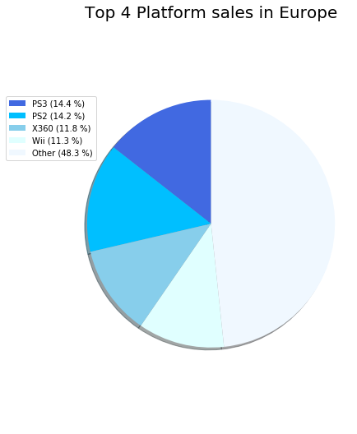
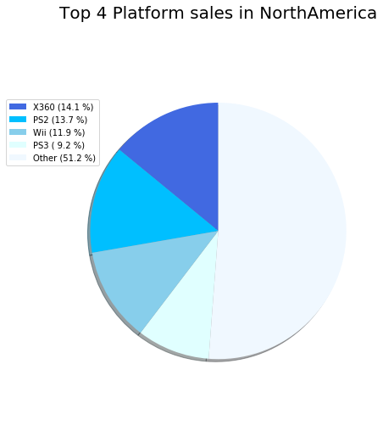
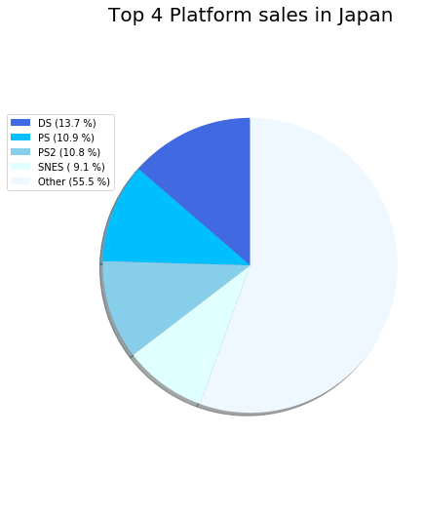
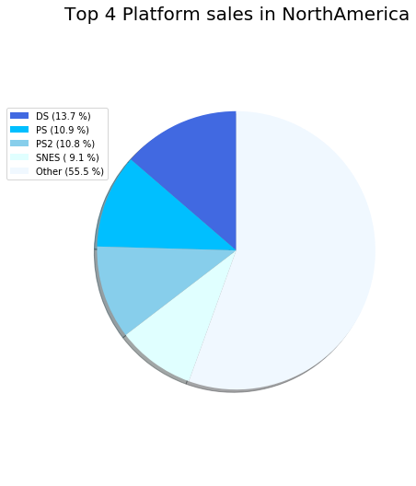
Platform Sales Trend––Area

Slide 9
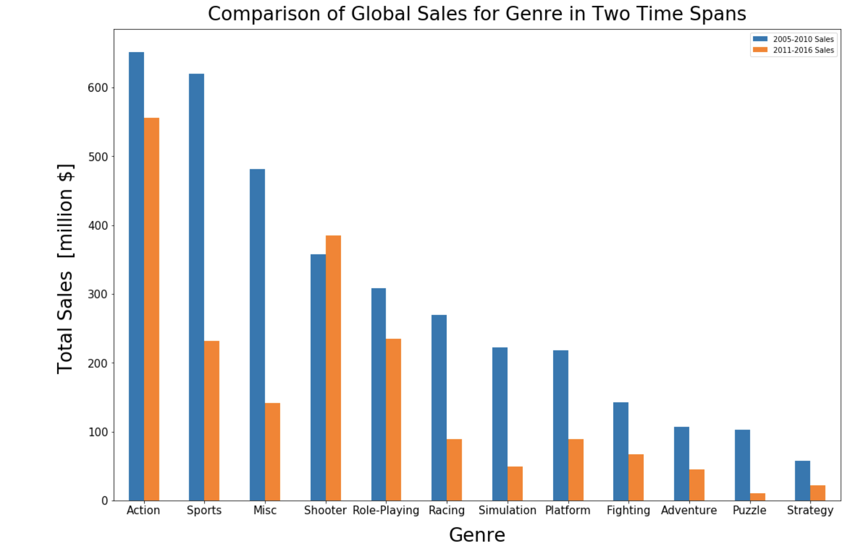
Game types total sale——trend
The hot sale of shooter games lasts longer
Notes:
https://www.prnewswire.com/news-releases/americans-cash-in-on-recession-savings-in-pursuit-of-experiential-activities-leisure-and-entertainment-markets-continue-to-thrive-while-clothing-and-household-care-markets-take-a-hit-300281896.html

Slide 10
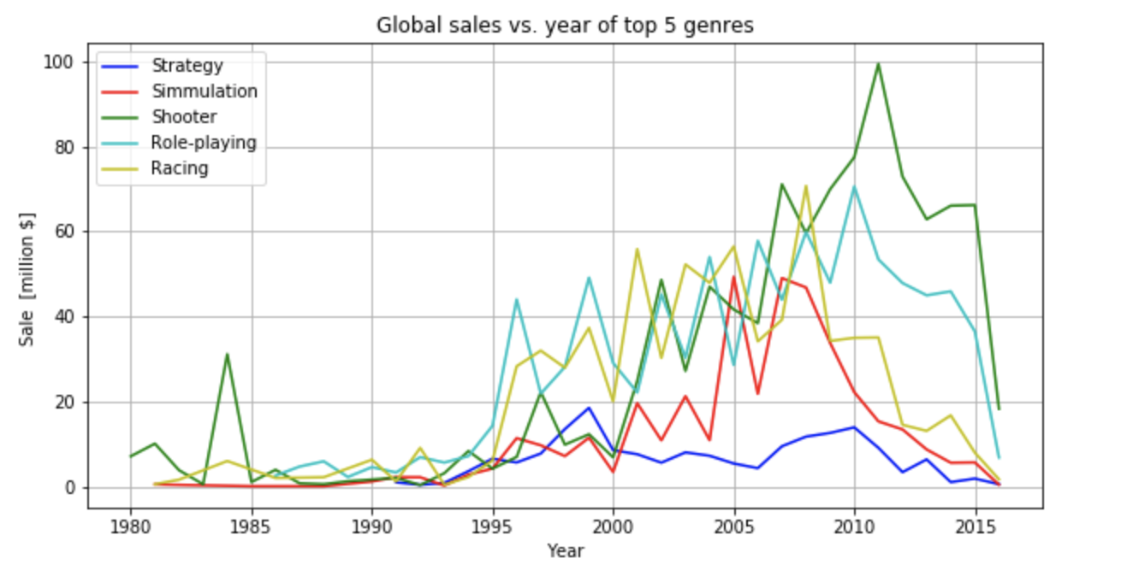
Game types total sale——trend
Independent of time fluctuation, preference of game types maintain consistency

Slide 11
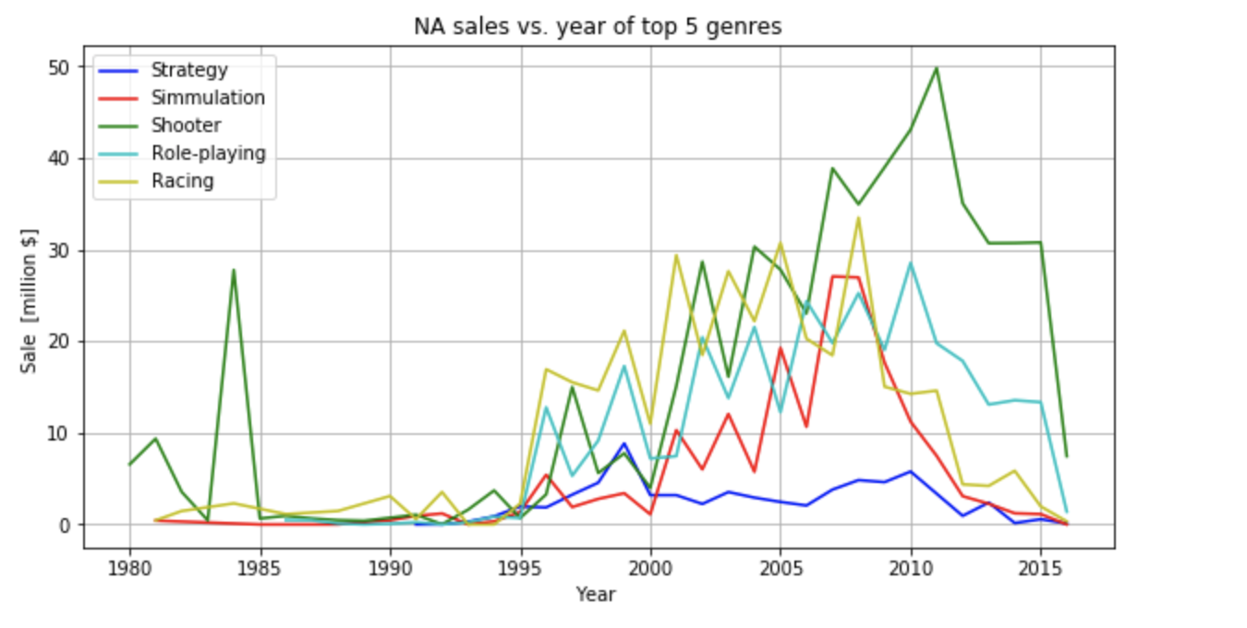
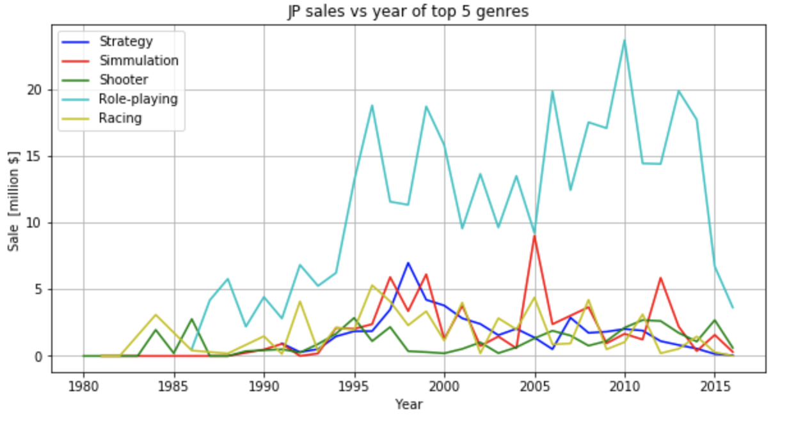
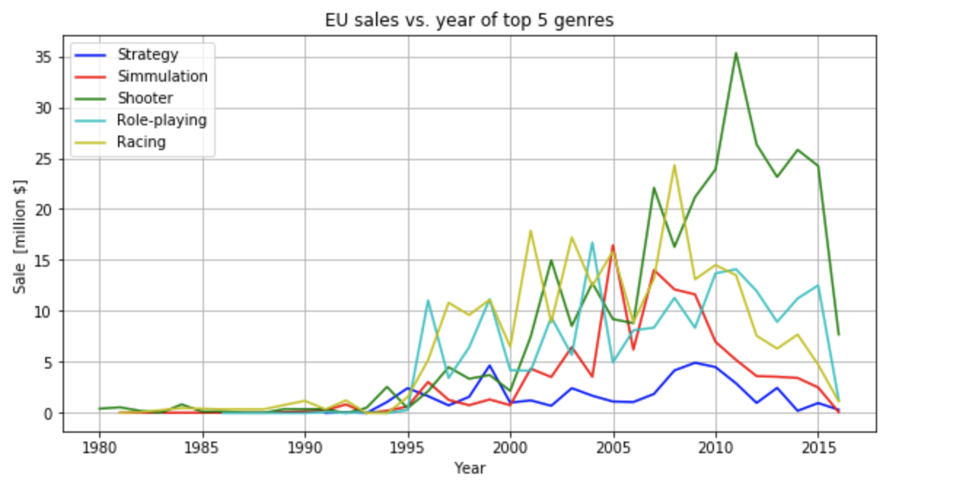
Game types sale——trend (area)
Japan shows the preference of different game types

Slide 12
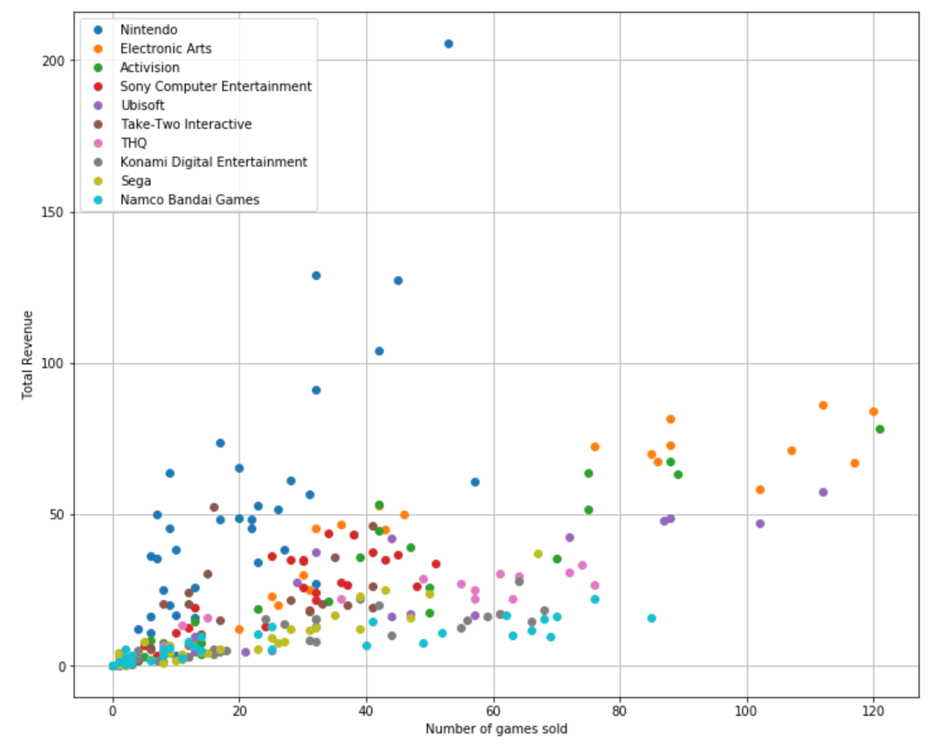
Strategies
It is better to specialize rather than brute-force release volumously

Slide 13
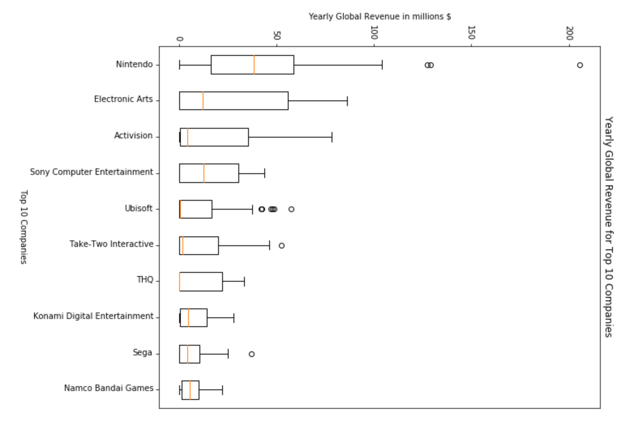
Strategies
On average per year
Yearly rate > overall gains

Slide 14
Questions

